Slide 1
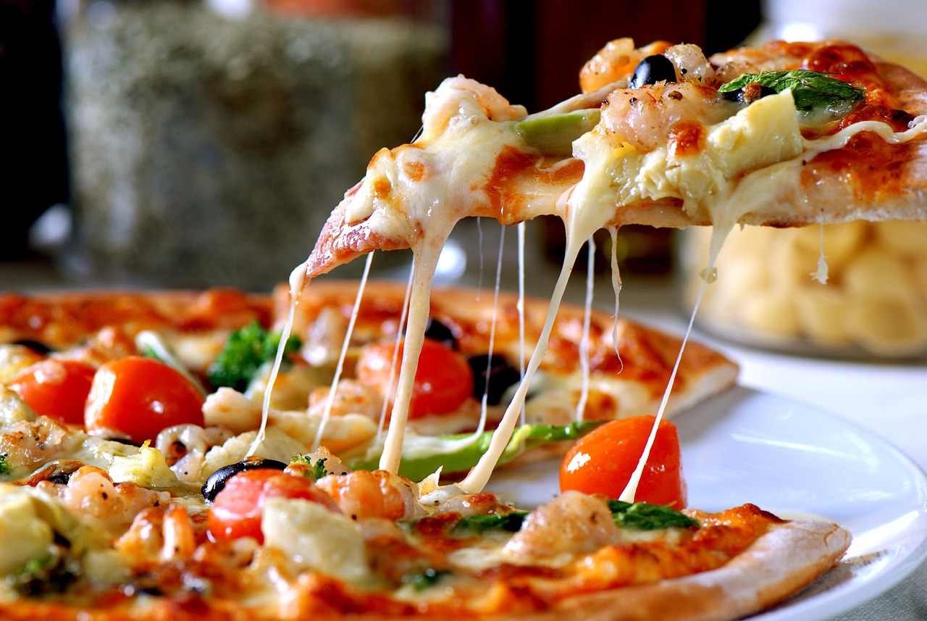
PIZZA BOXCAR
-BY YUKTI BHALLA

Slide 2

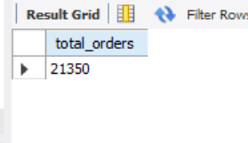
-- Retrieve the total number of orders placed.

Slide 3
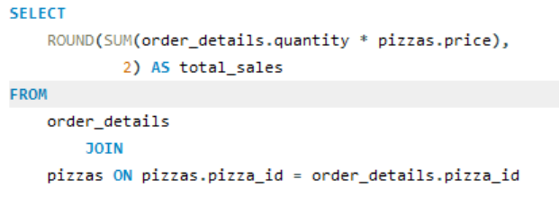
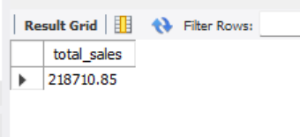
-- Calculate the total revenue generated from pizza sales.

Slide 4
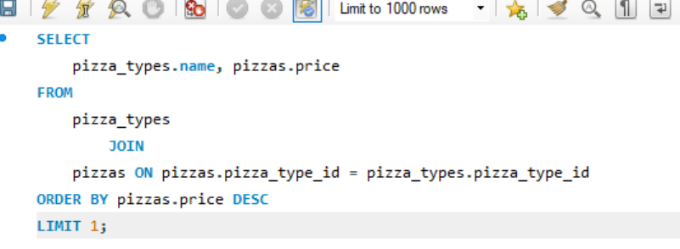
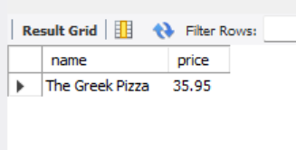
-- Identify the highest-priced pizza.

Slide 5

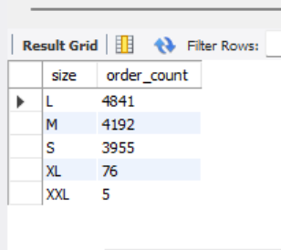
-- Identify the most common pizza size ordered.

Slide 6
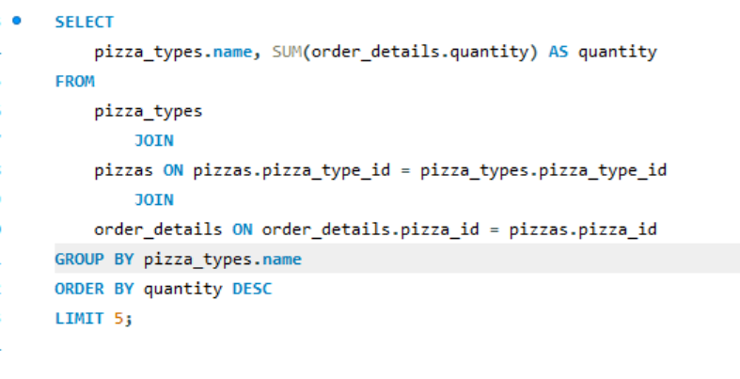
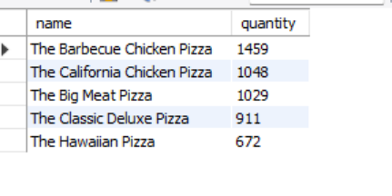
-- List the top 5 most ordered pizza types along with their quantities.

Slide 7
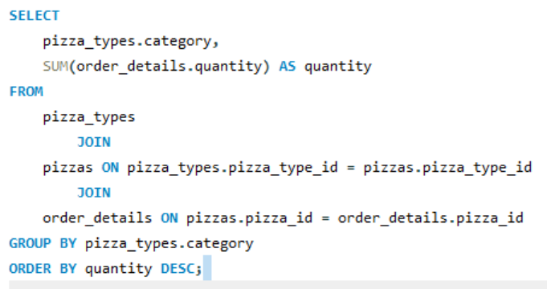
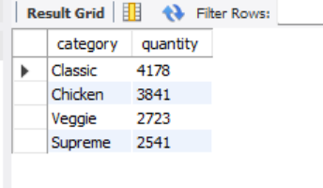
-- Identify the most common pizza size ordered.

Slide 8

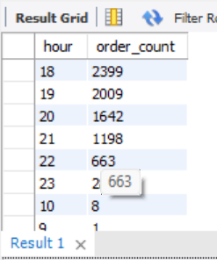
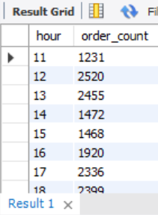
-- Determine the distribution of orders by hour of the day.

Slide 9

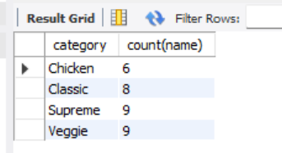
-- Join relevant tables to find the category-wise distribution of pizzas

Slide 10

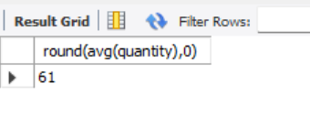
-- Group the orders by date and calculate the average number of pizzas ordered per day.

Slide 11

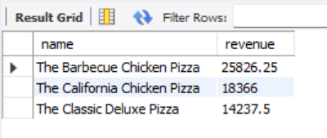
-- Determine the top 3 most ordered pizza types based on revenue.

Slide 12
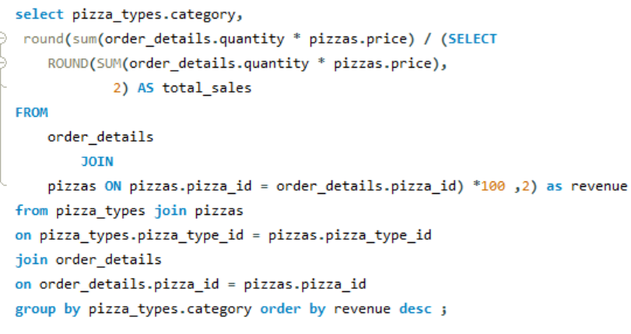
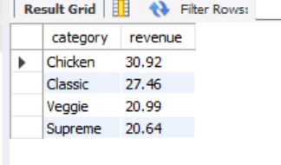
-- Calculate the percentage contribution of each pizza type to total revenue.

Slide 13
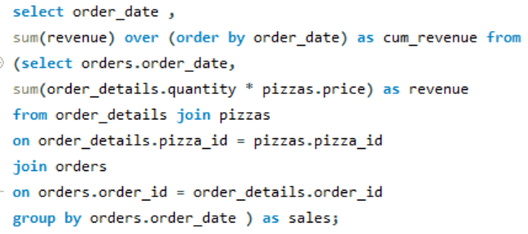
-- Analyze the cumulative revenue generated over time.

Slide 14
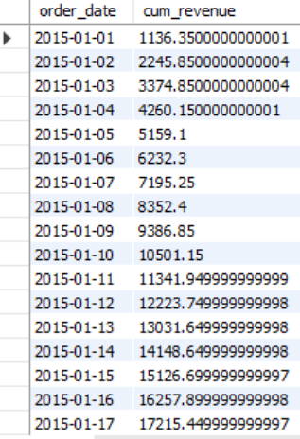
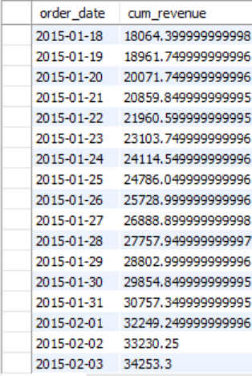
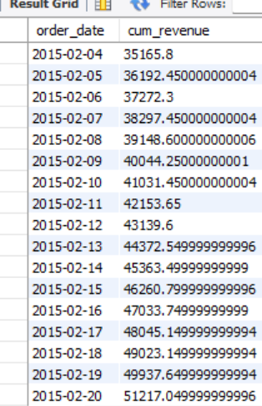
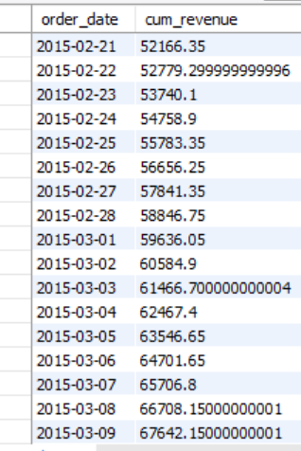

Slide 15


